Slide 1
Congruence Relations And Its Applications

Slide 2
Definition
In abstract algebra, a congruence relation (or simply congruence) is an equivalence relation on an algebraic structure (such as a group, ring, or vector space) that is compatible with the structure in the sense that algebraic operations done with equivalent elements will yield equivalent elements.
Every congruence relation has a corresponding quotient structure, whose elements are the equivalence classes (or congruence classes) for the relation.

Slide 3
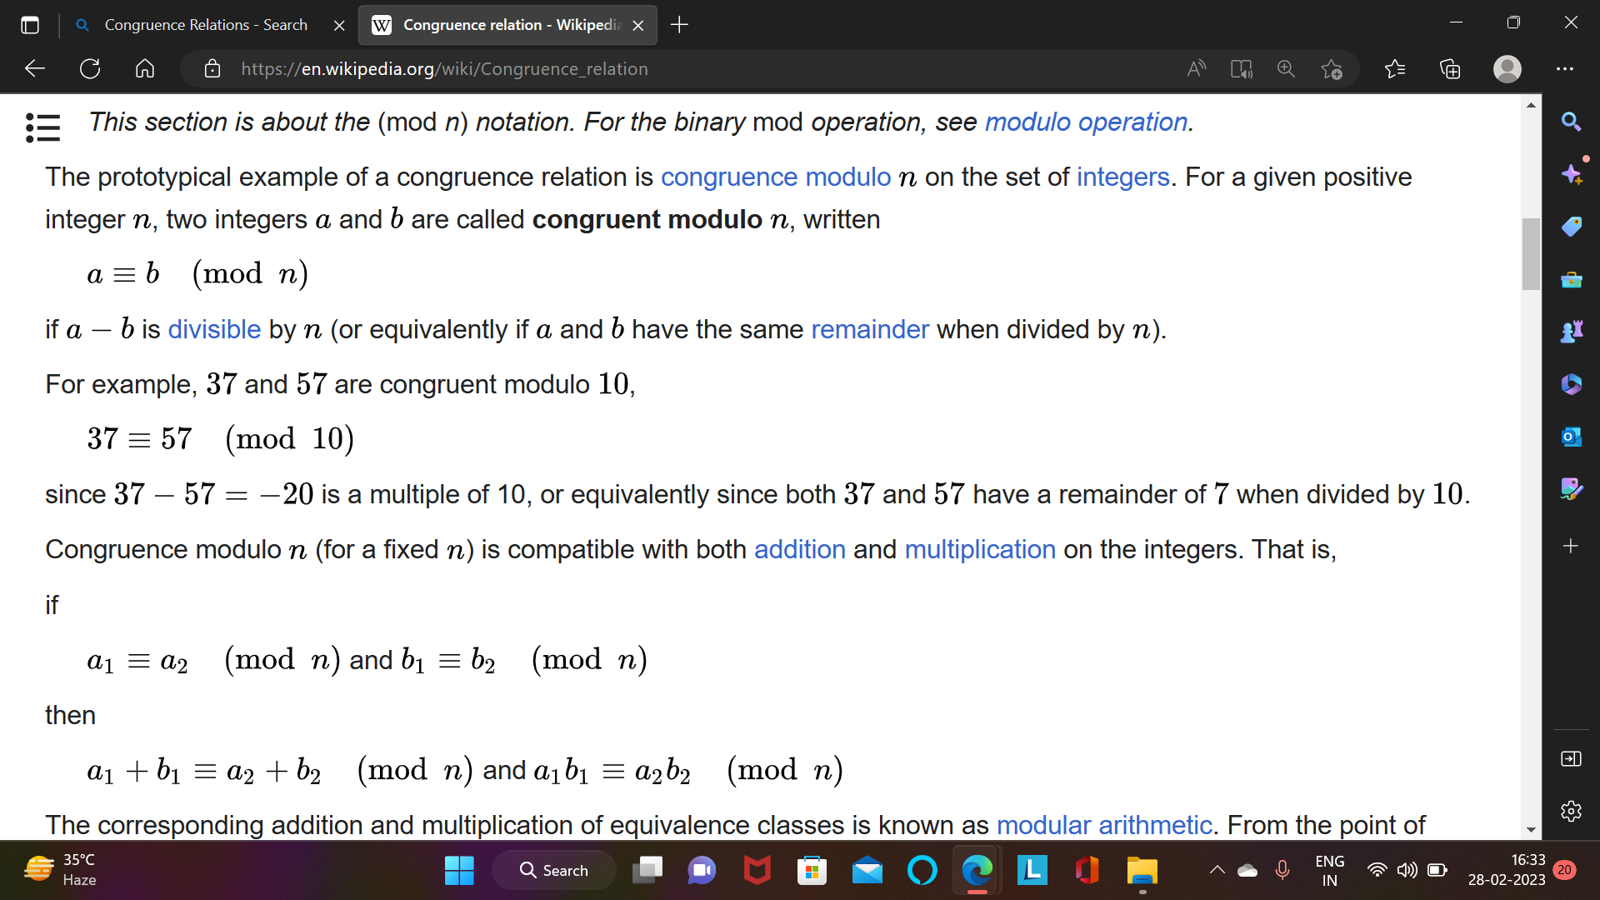

Slide 4
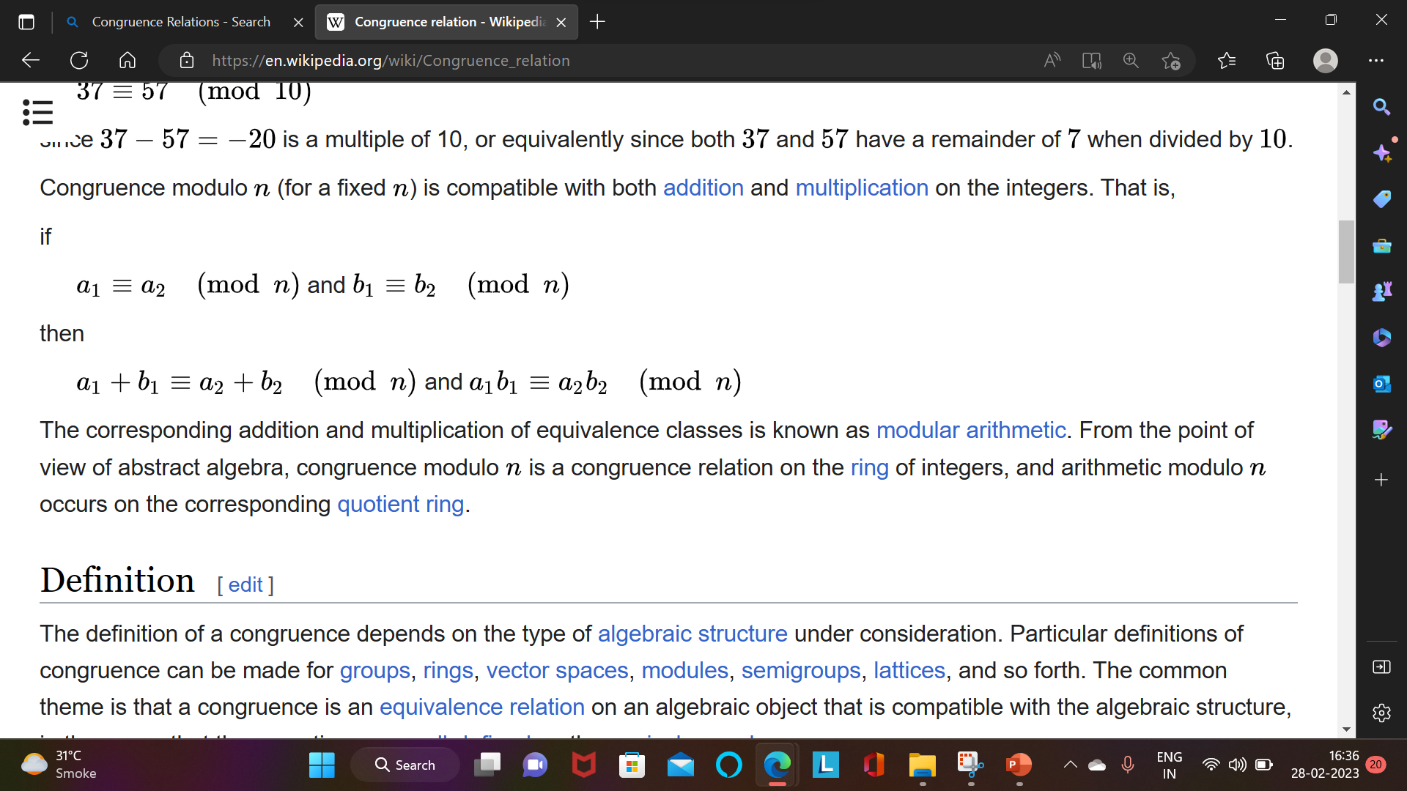

Slide 5
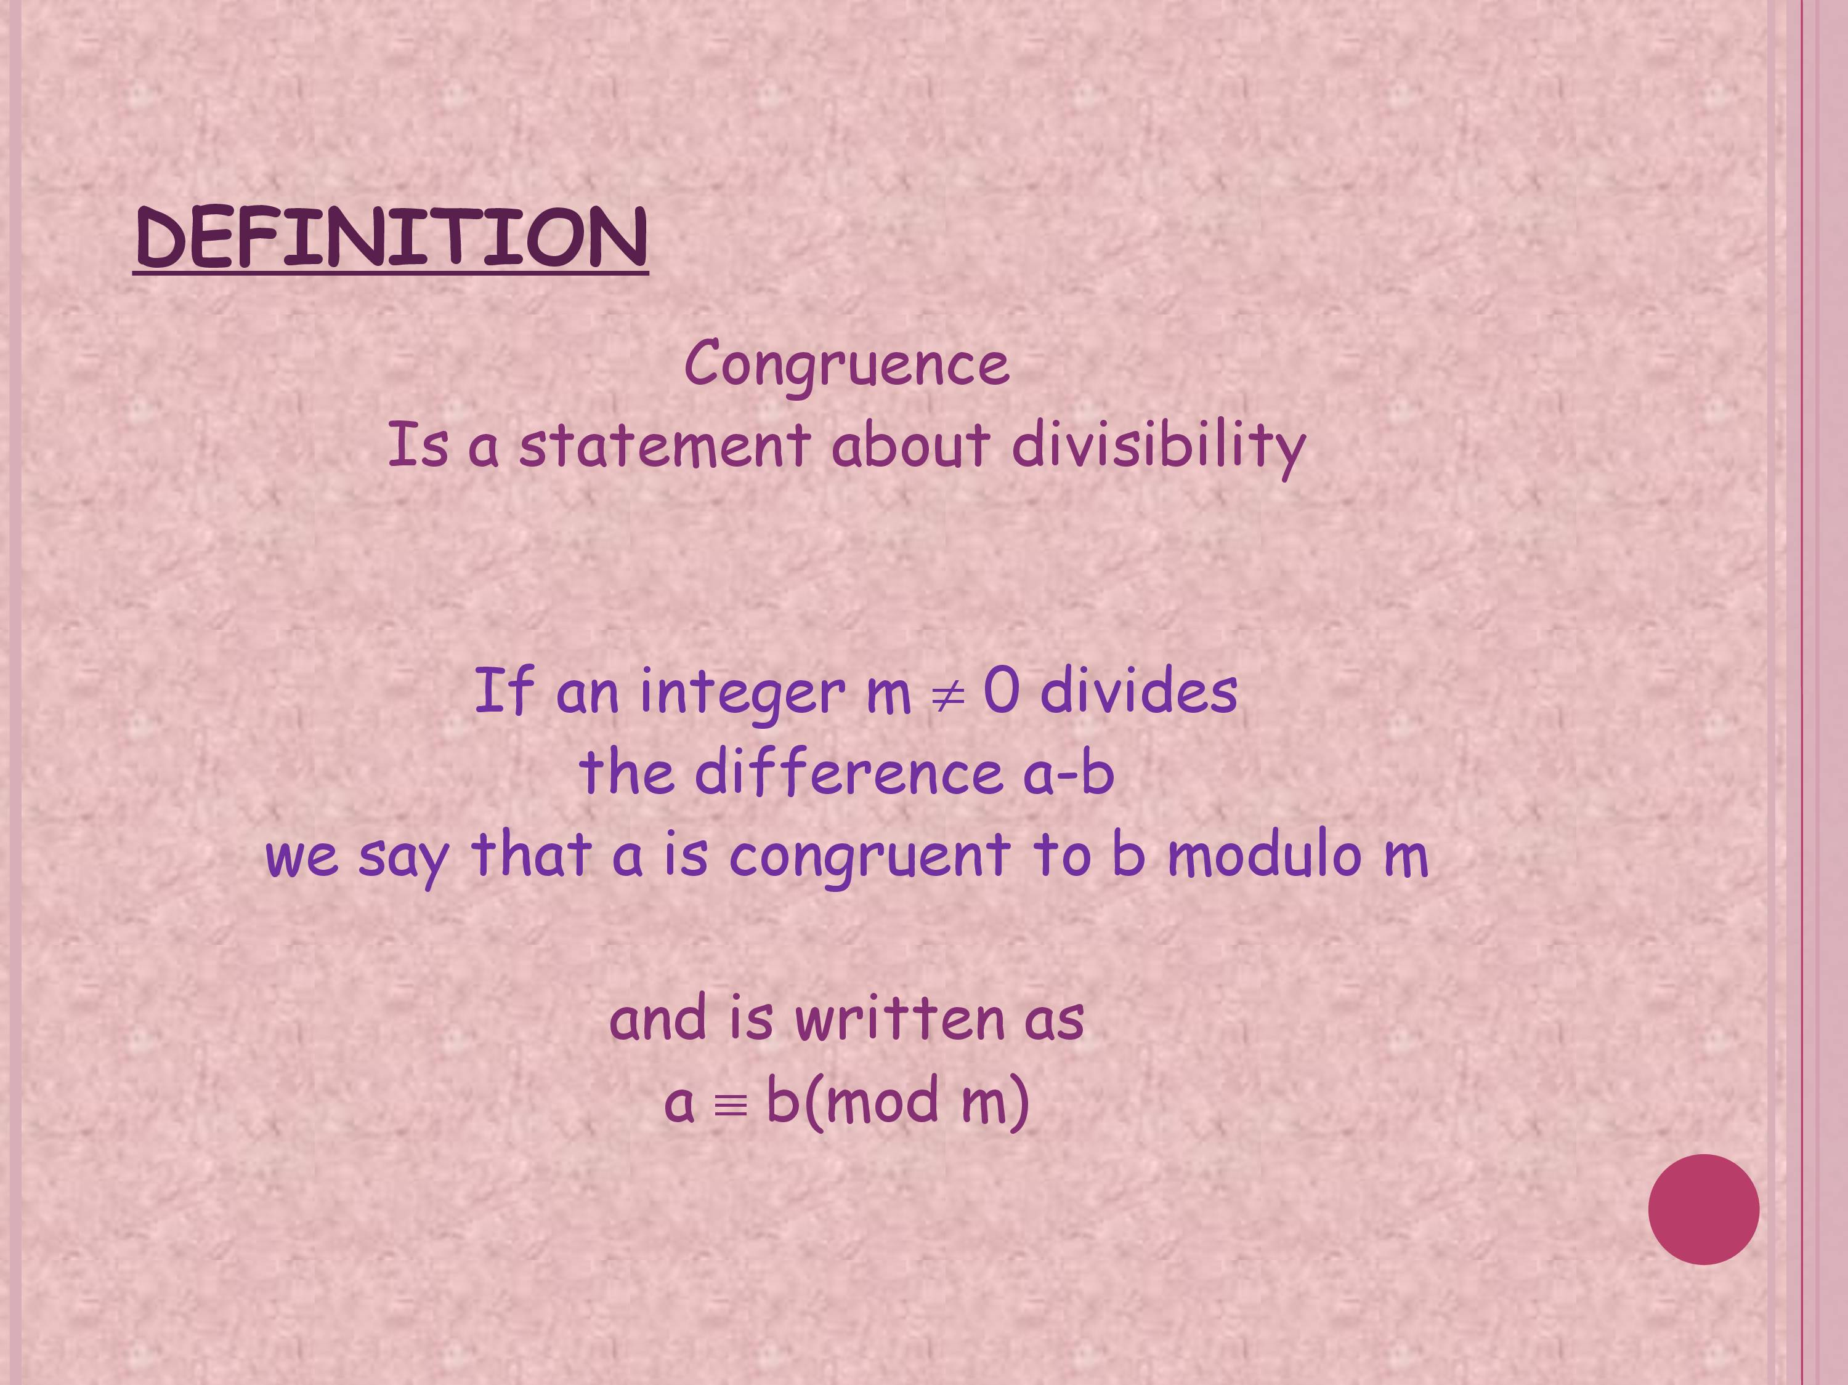

Slide 6
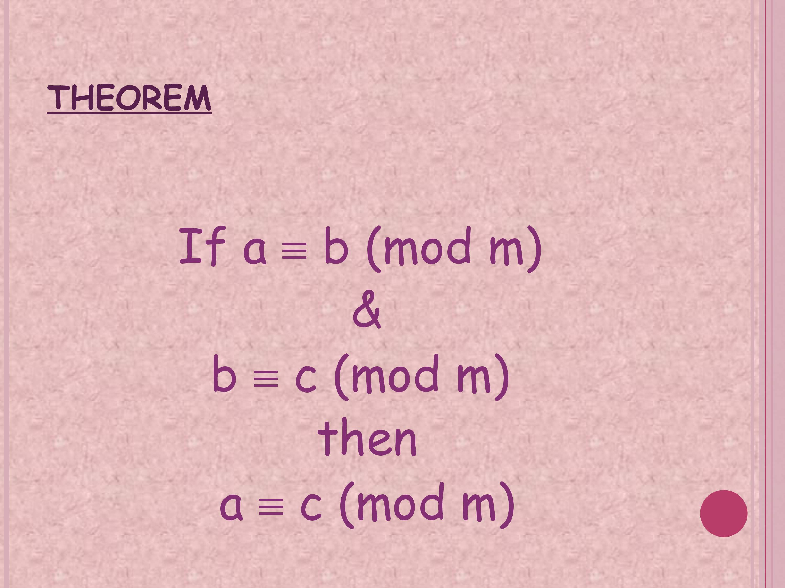

Slide 7
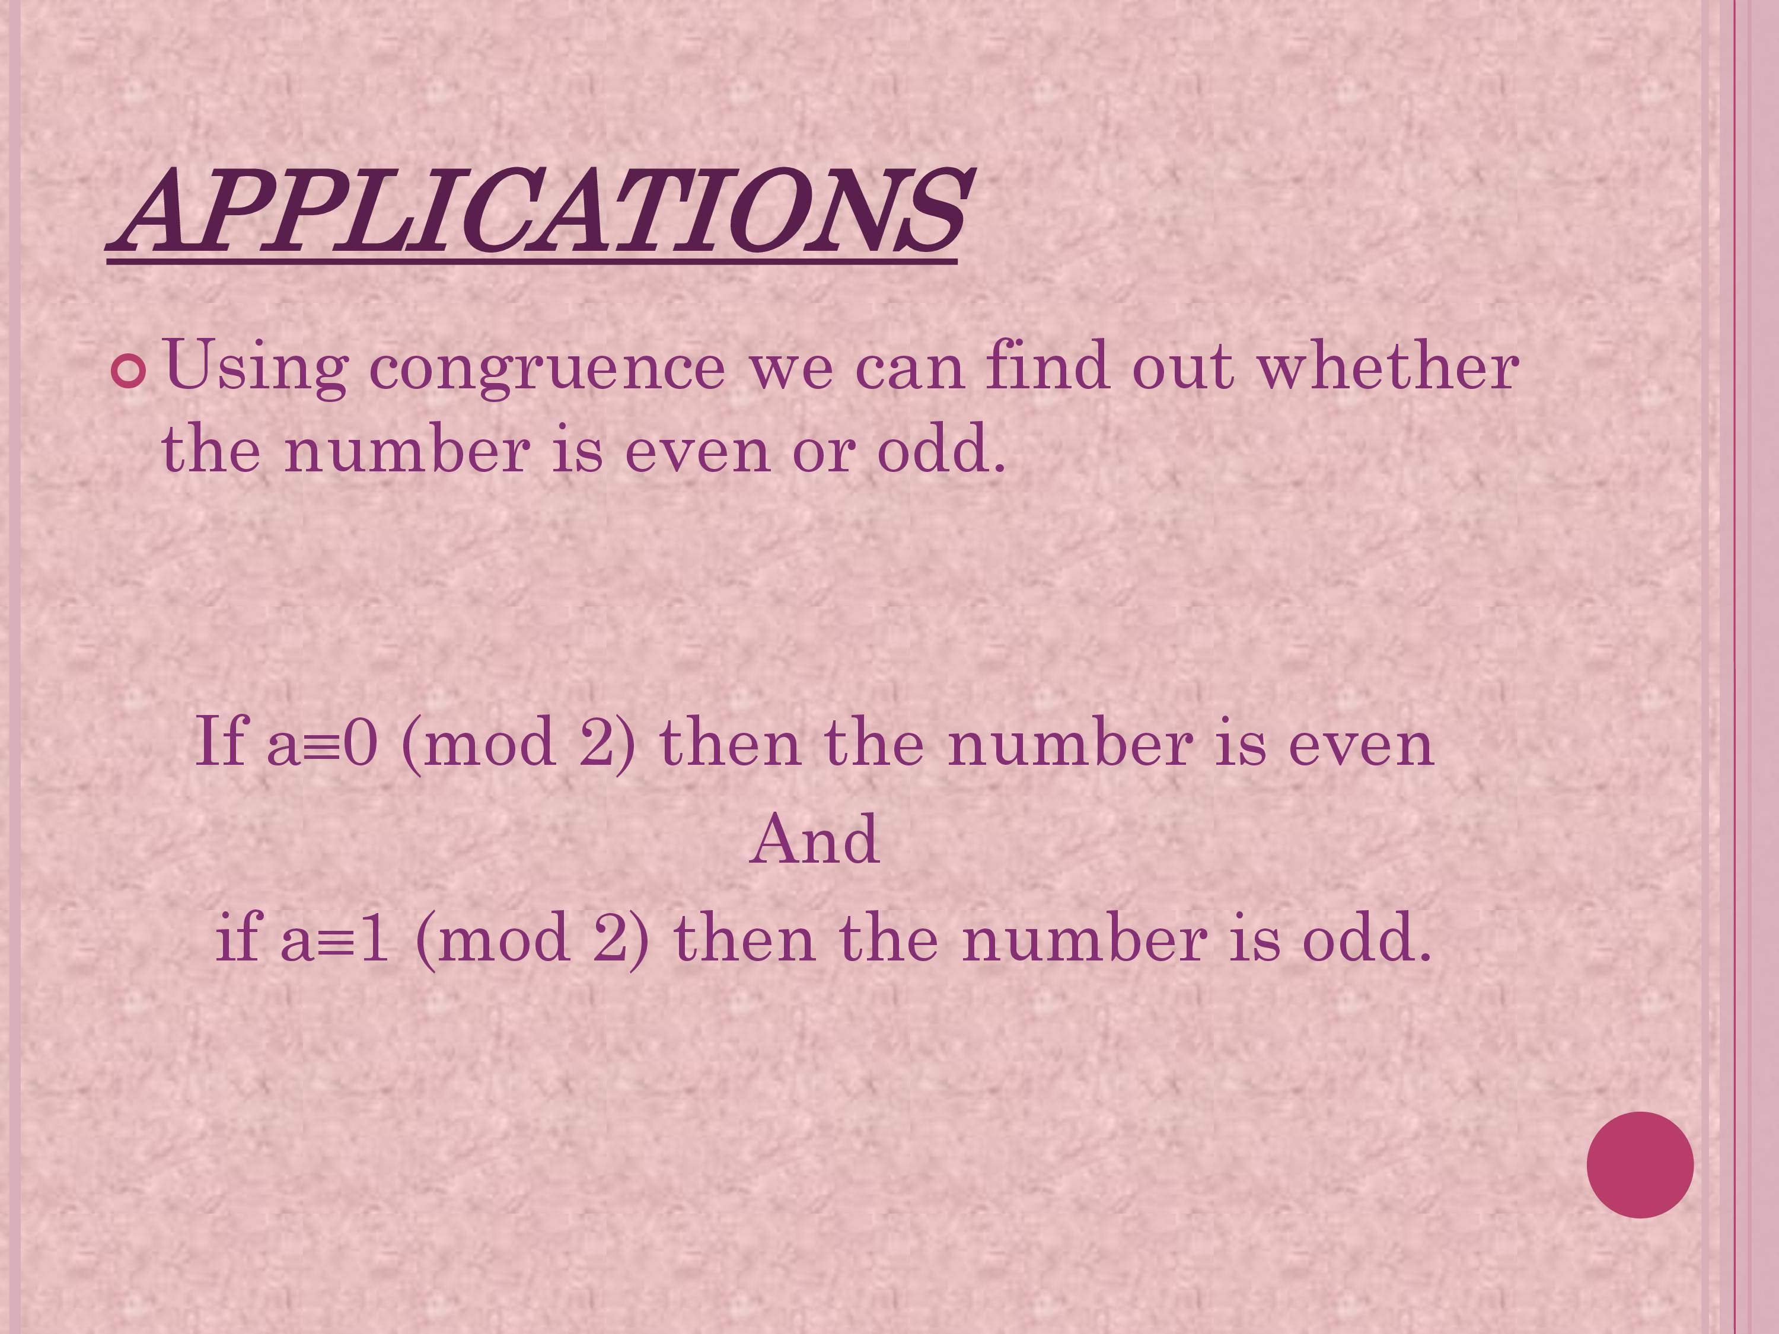

Slide 8
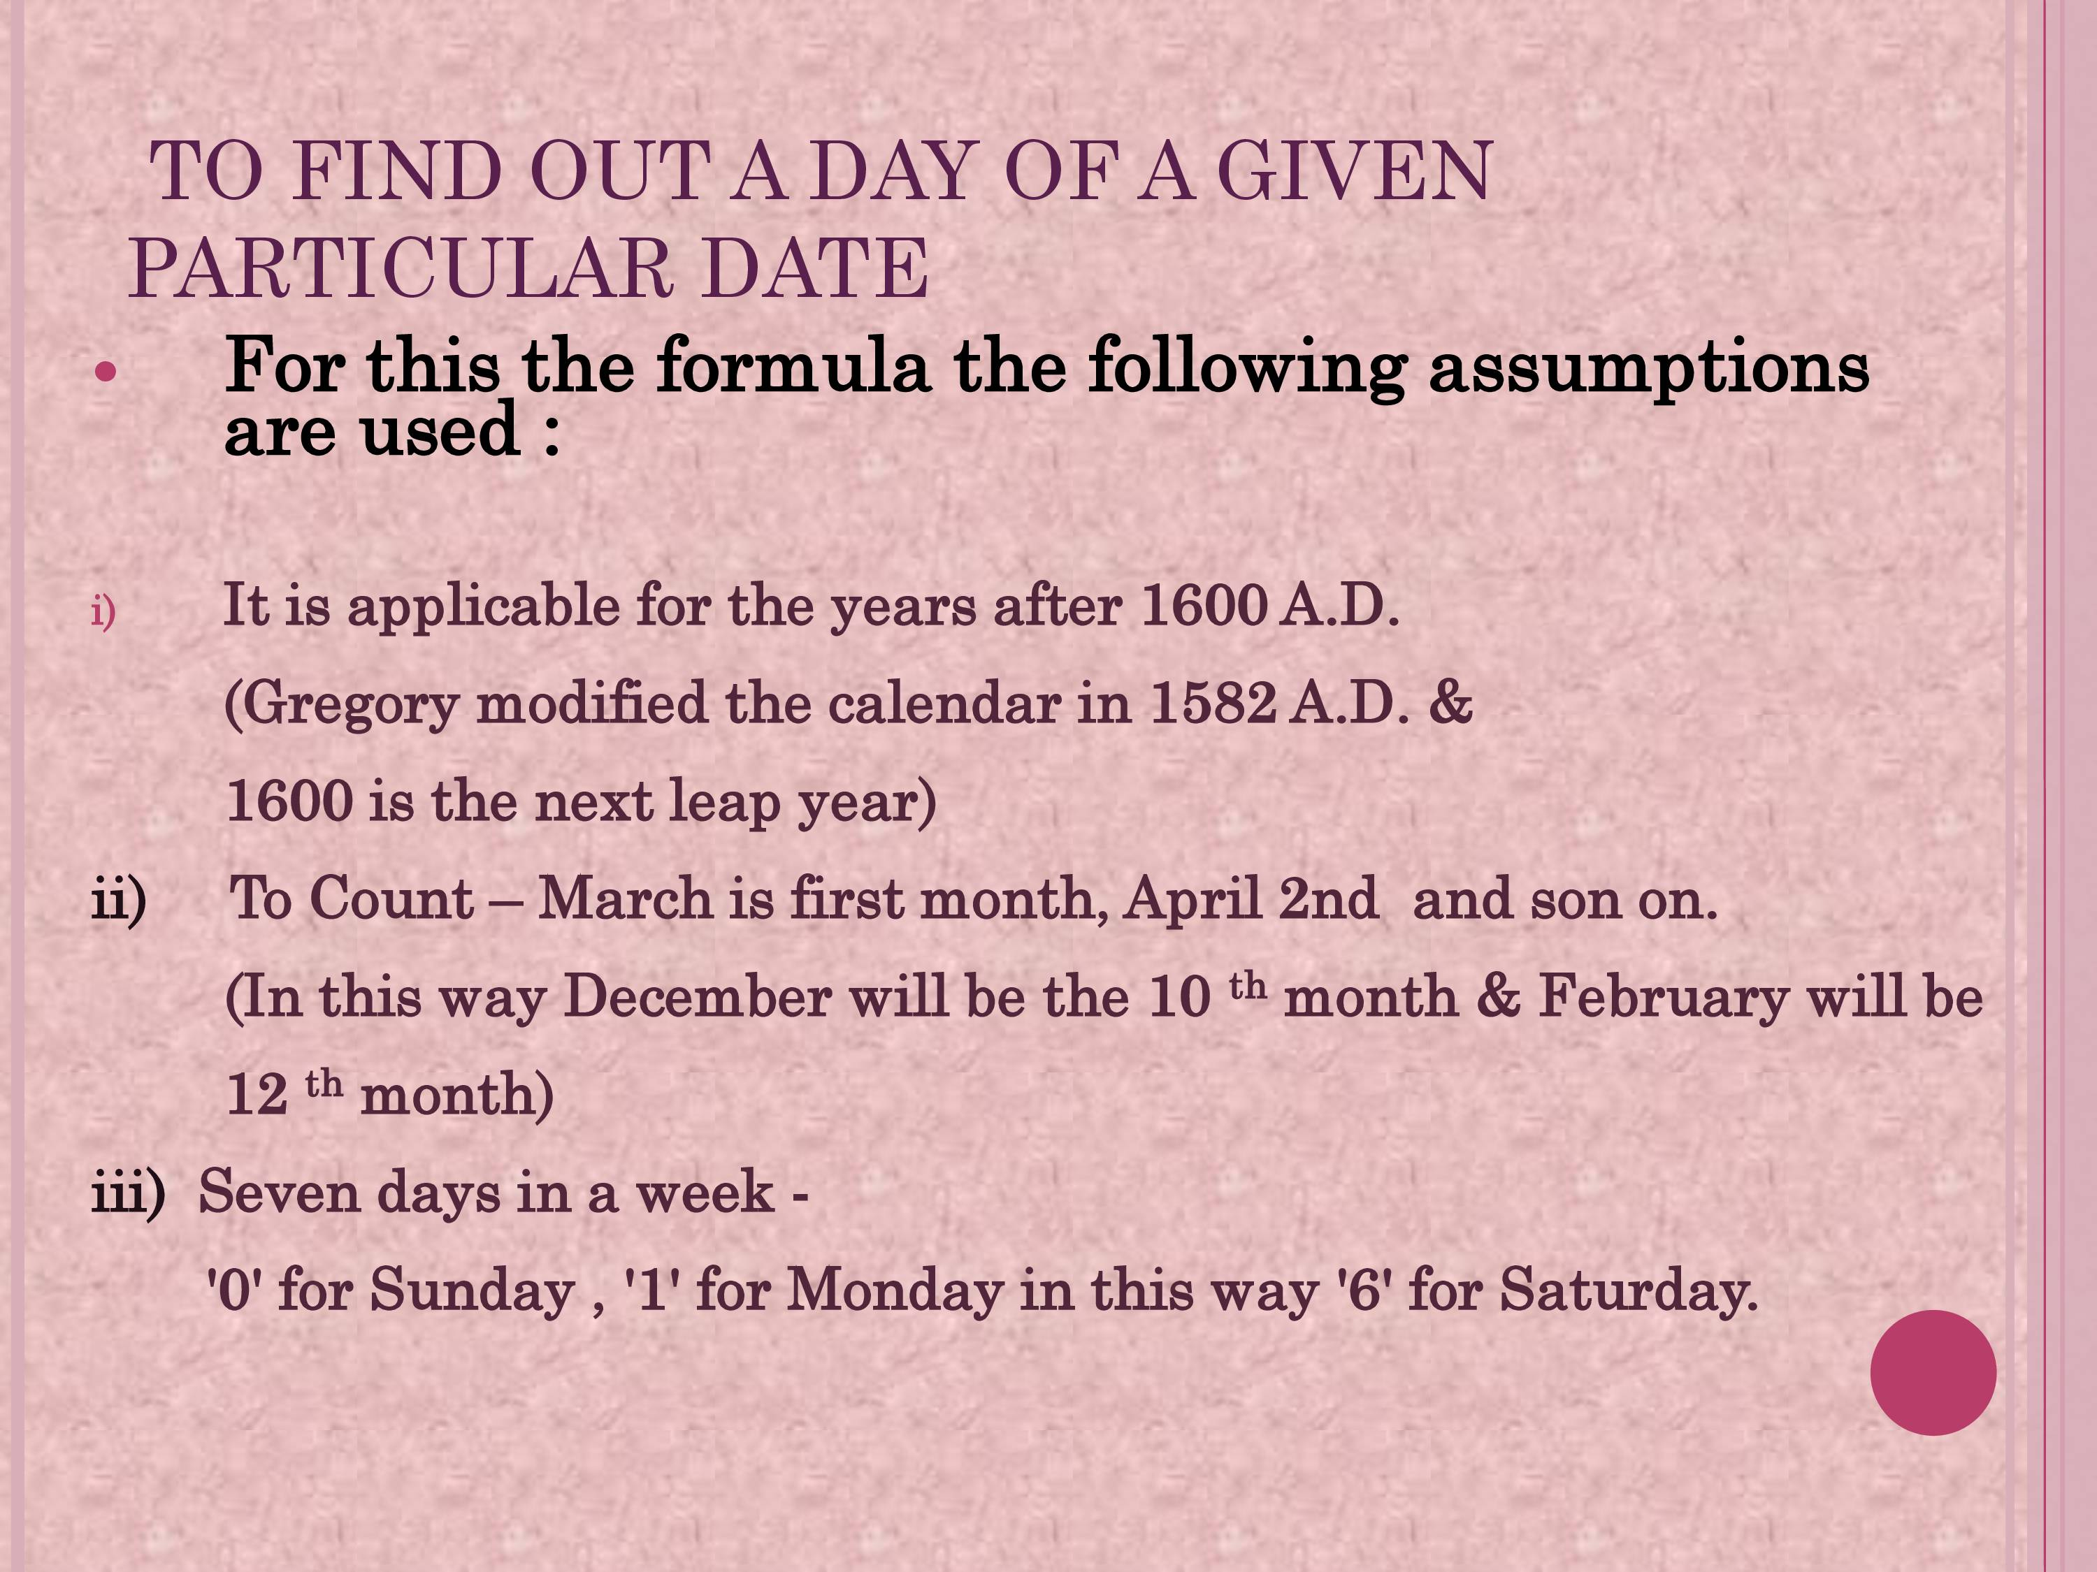

Slide 9
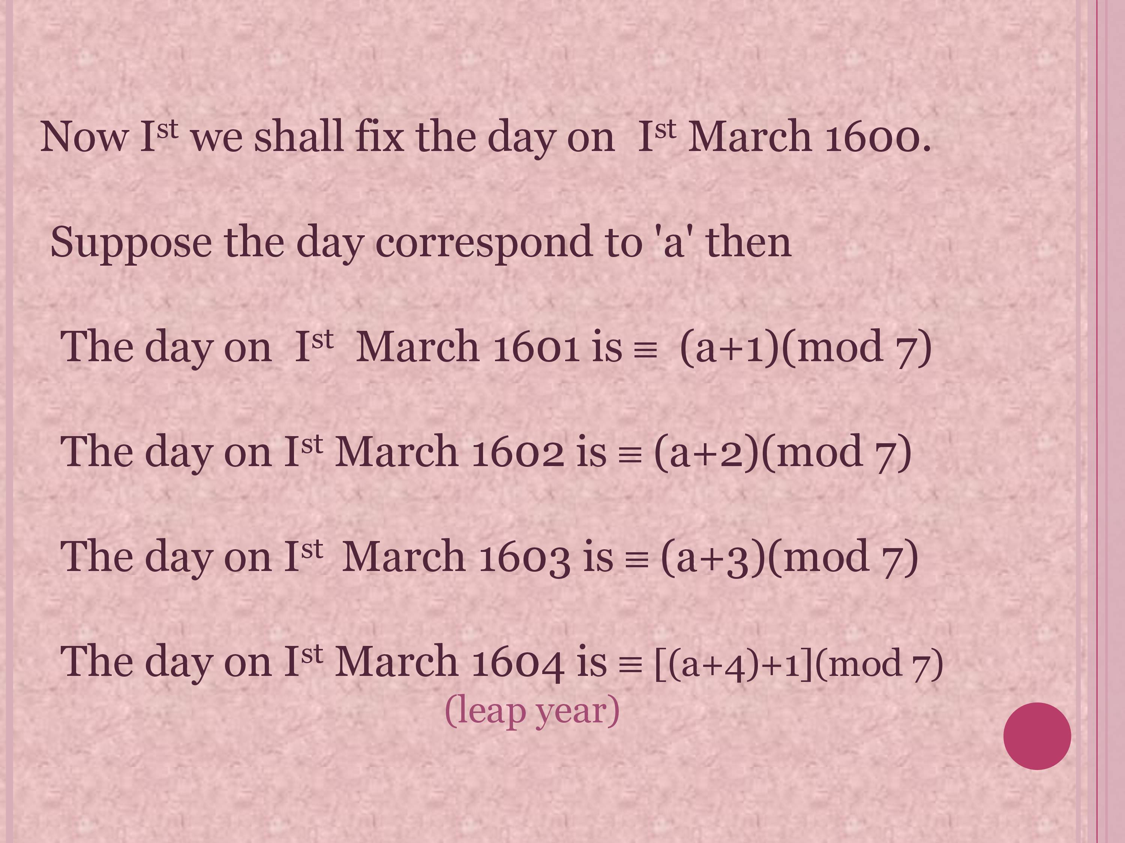

Slide 10
